Slide 1


Machine learning based visual style advisor for personalized fashion and beauty recommendations
24-25J-155
Progress Presentation 2
17/03/2025

Slide 2
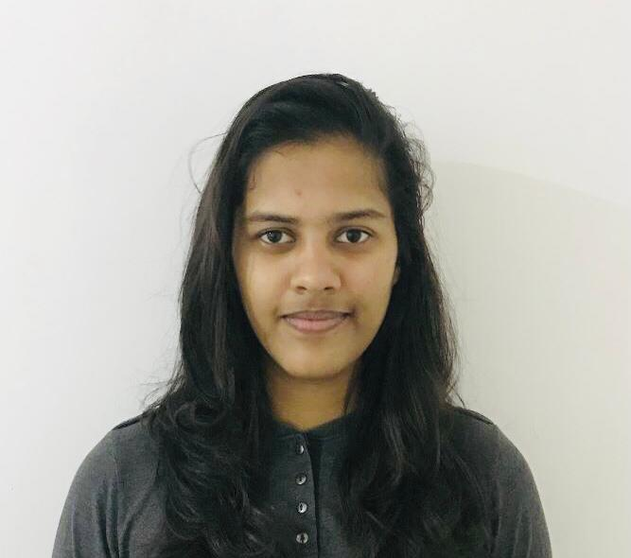




Meet Our Team !
Prasadi S.A.D.T.
IT21894824
Shaakir J.H.M.
IT21322280
Vikasitha M.K.I.
IT21180798
Senarathne D.R.
IT21213144
17/03/2025

Slide 3
OVERALL PROJECT DESCRIPTION
This project introduces an innovative Machine Learning-Based Visual Style Advisor designed to revolutionize the way individuals approach fashion and beauty. The system provides personalized recommendations for haircuts, hair colors, clothing, and makeup by analyzing a user’s unique facial features, body type, and other personal attributes. Leveraging advanced technologies such as machine learning, deep learning, computer vision, and real-time applications, the system ensures accurate and contextually appropriate suggestions tailored to each user.
17/03/2025

Slide 4
RESEARCH PROBLEM
How to accurately extract and classify facial features and body types for personalized fashion and beauty recommendations?
How to analyze the interaction between multiple attributes and suggest a recommendation using machine learning and deep learning techniques?
How to develop an efficient and user-friendly virtual try-on system that allows real-time visualization of recommended hairstyles and hair colors?
How to minimize manual input errors and enhance recommendation accuracy by automating feature extraction through computer vision?
17/03/2025

Slide 5
RESEARCH OBJECTIVES
Main Objective
Sub Objectives
Machine learning based personalized fashion and beauty recommendation system for the young generation.
Hair Style Transformation and Realistic Simulation for Personalized Recommendations
Personalized Hair Color Recommendation with Real-Time Application
Clothing Recommendation based on body type & skin tone
Makeup recommendation based on facial features
17/03/2025

Slide 6
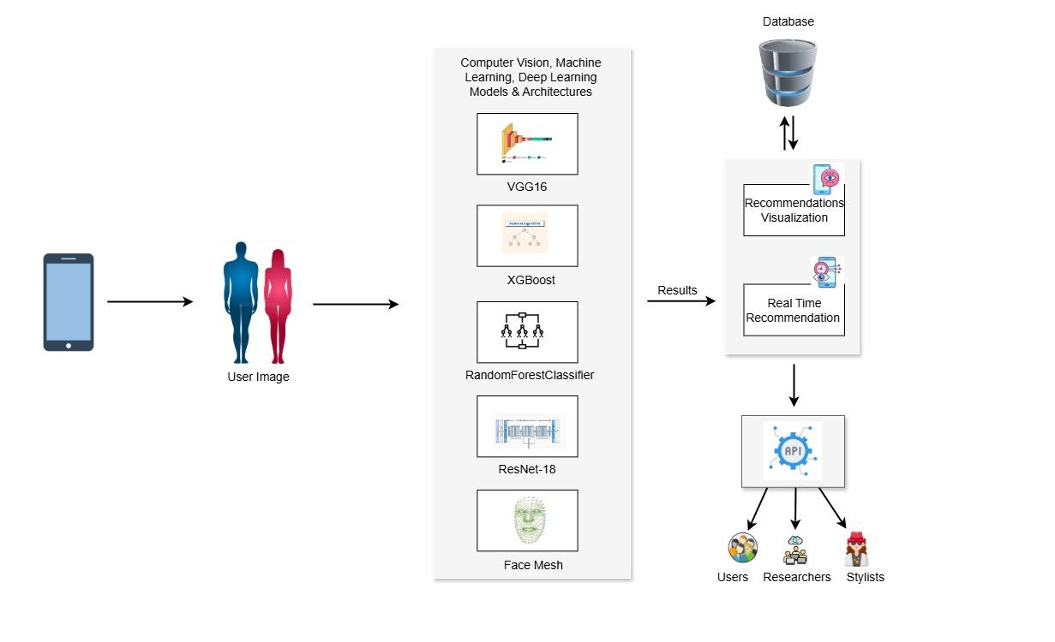
17/03/2025

Slide 7
IT21894824 | Prasadi S.A.D.T.
Specialization : Information Technology
IT21894824 | Prasadi S.A.D.T. | 24-25J-155
17/3/2025

Slide 8
Personalized Hair Color Recommendation with Real-Time Application
IT21894824 | Prasadi S.A.D.T. | 24-25J-155
17/3/2025

Slide 9
Methodology
Data Collection
Data pre-processing
Used Machine learning architectures for training models
Data augmentation and selected the best technique to retrain models to achieve good fitting
Tuning hyper-parameters and retrained models to select the best architecture
Data Visualization
Host the finalized model in the flask server
Displayed the results in mobile application
IT21894824 | Prasadi S.A.D.T. | 24-25J-155
17/3/2025

Slide 10
Specific and Sub Objective
Identification of User Facial Features
Personalized Hair Color Recommendation with Real-Time Application
Identification of Optimal Hair Color Based on User Attributes
Identification of Best Architecture for Hair Color Recommendation
. Identification of Hair Color Application Severity Levels
IT21894824 | Prasadi S.A.D.T. | 24-25J-155
17/3/2025

Slide 11
Research Problem
How can we develop an accurate model that recommends personalized hair colors based on multiple user attributes using machine learning techniques?
What techniques and algorithms are most effective for extracting relevant features from user images and integrating them with user-provided information to create comprehensive input for hair color recommendations?
How can we implement a real-time system that both recommends optimal hair colors and visually applies these recommendations to user images to provide immediate, realistic feedback on potential appearance changes?
IT21894824 | Prasadi S.A.D.T. | 24-25J-155
17/3/2025

Slide 12
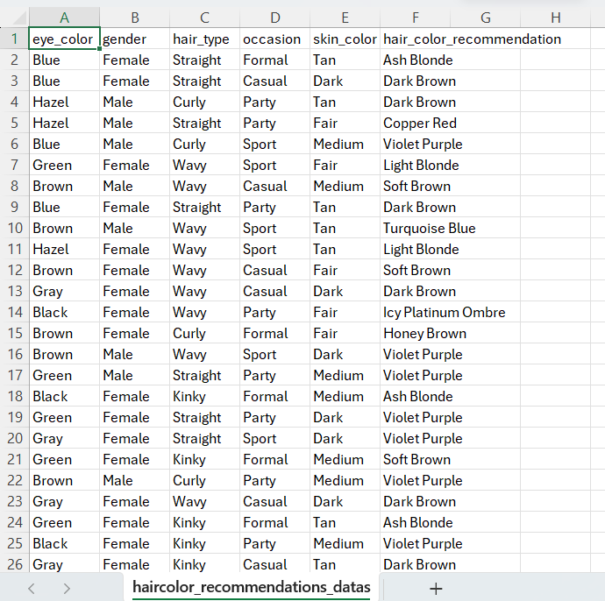
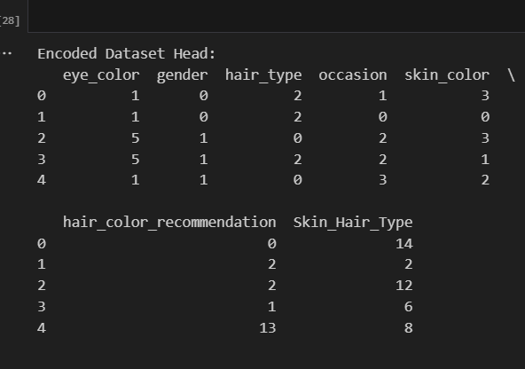
Finalized Dataset
Dataset contains 986,900 rows and 6 columns. The dataset appears to be related to hair color recommendations based on different attributes.
Eye color – (Blue, Hazel, Green, Brown, Gray, Blackl
Gender – Male, Female
Hair type – Straight, Curly, Wavy, Kinky
Occasion – Formal, Casual, Party, Sport
Skin color – Tan, Dark, Fair, Medium
Hair color recommendation – Ash Blonde, Dark Brown, Copper Red, Violet Purple, Light Blonde, Soft Brown, Turquoise Blue, Icy Platinum Ombre, Honey Brown, Silver, Neon Pink, Sunset Highlights, Platinum Blonde, Golden Blonde
IT21894824 | Prasadi S.A.D.T. | 24-25J-155
17/3/2025

Slide 13
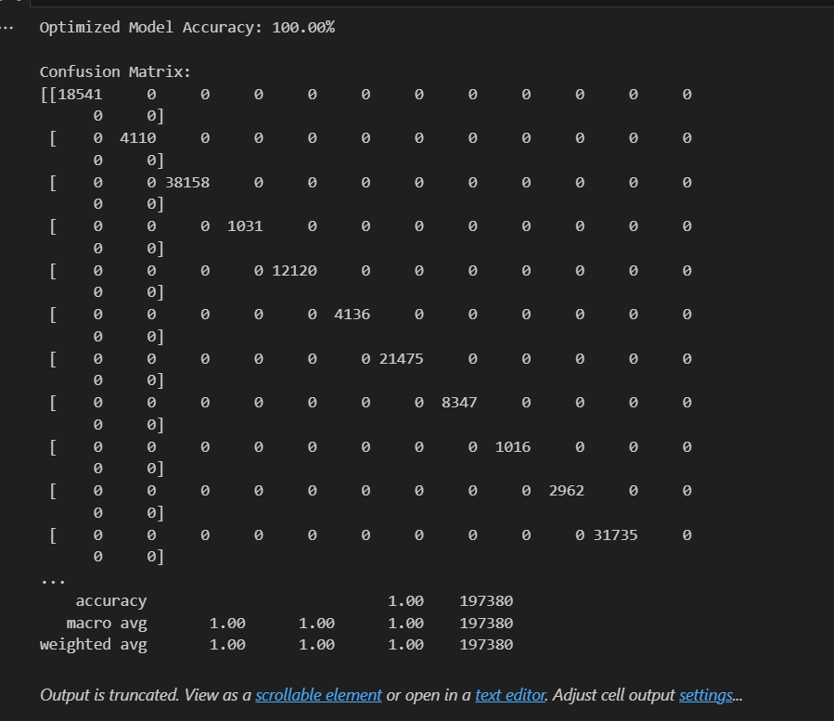
Expected Output of the Model
Why XGBoost?
XGBoost is used for the following reasons:
It is highly efficient, fast, and optimized for large datasets.
It prevents overfitting through regularization techniques.
It can model complex, non-linear relationships between features.
It supports parallel processing, making the training process faster.
It performs well in classification tasks, such as predicting hair color based on user features.
Accuracy: The model is expected to achieve a high accuracy rate (above 90%) after proper tuning.
IT21894824 | Prasadi S.A.D.T. | 24-25J-155
17/3/2025

Slide 14
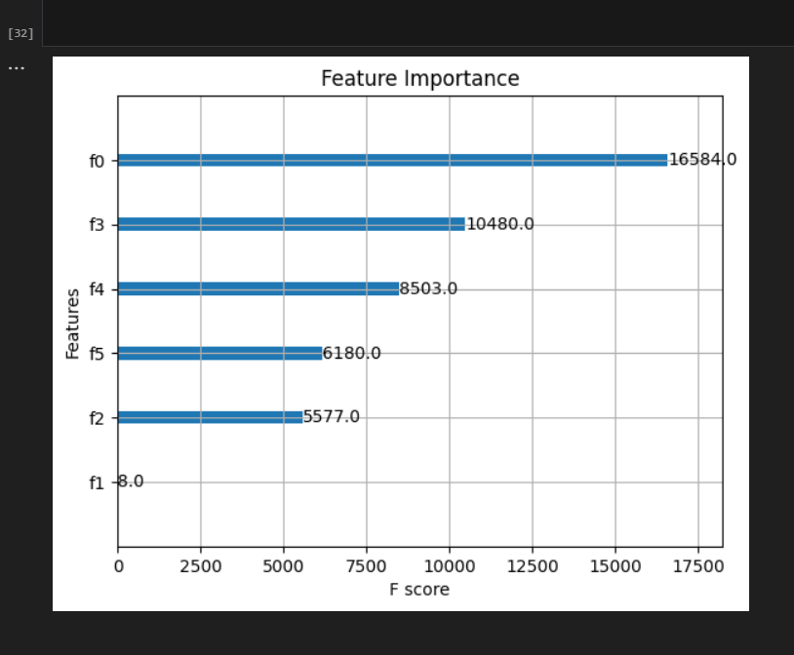
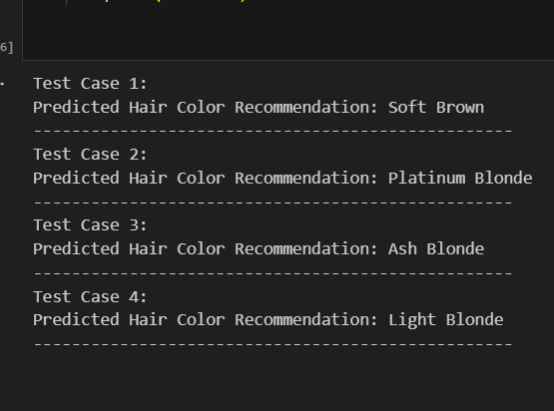
Model Configuration
Training Dataset: 80% of the dataset for training.
Testing Dataset: 20% of the dataset for testing.
Oversampling: SMOTE is applied to balance the classes.
Prediction 1: Soft Brown - A rich brown shade ideal for medium to fair skin tones.
Prediction 2: Golden Blonde - A light and warm shade perfect for individuals with fair skin and blue eyes.
Prediction 3: Ash Black - A dark and cool-toned color suitable for individuals with dark skin tones.
IT21894824 | Prasadi S.A.D.T. | 24-25J-155
17/3/2025

Slide 15
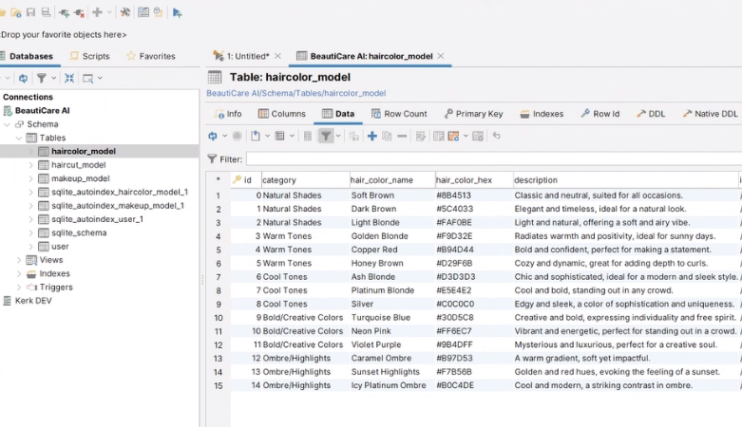
Recommended Hair Colors
IT21894824 | Prasadi S.A.D.T. | 24-25J-155
17/3/2025

Slide 16

Summary of sub objective achievement
Identification of User Facial Features
Identification of Optimal Hair Color Based on User Attributes
Identification of Best Architecture for Hair Color Recommendation
. Identification of Hair Color Application Severity Levels
IT21894824 | Prasadi S.A.D.T. | 24-25J-155
17/3/2025

Slide 17

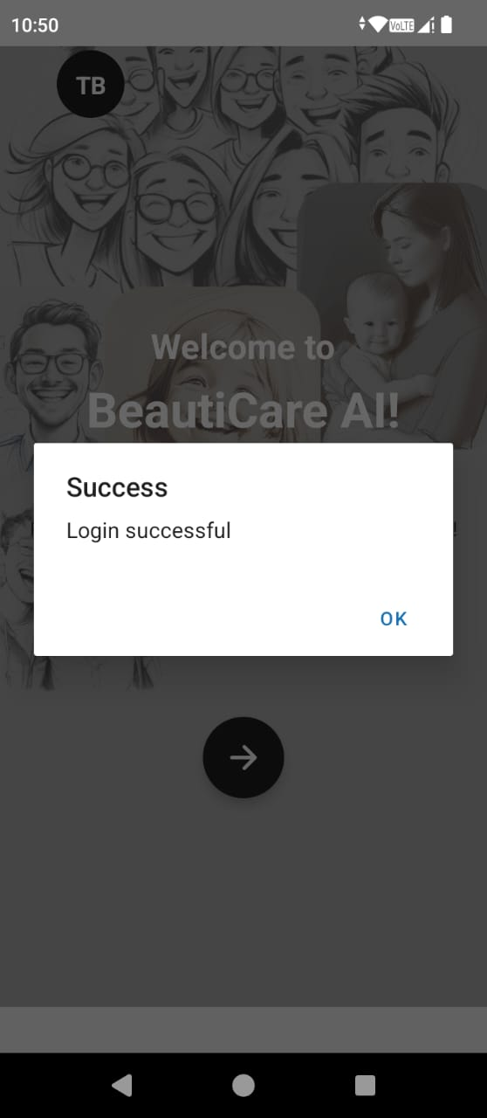
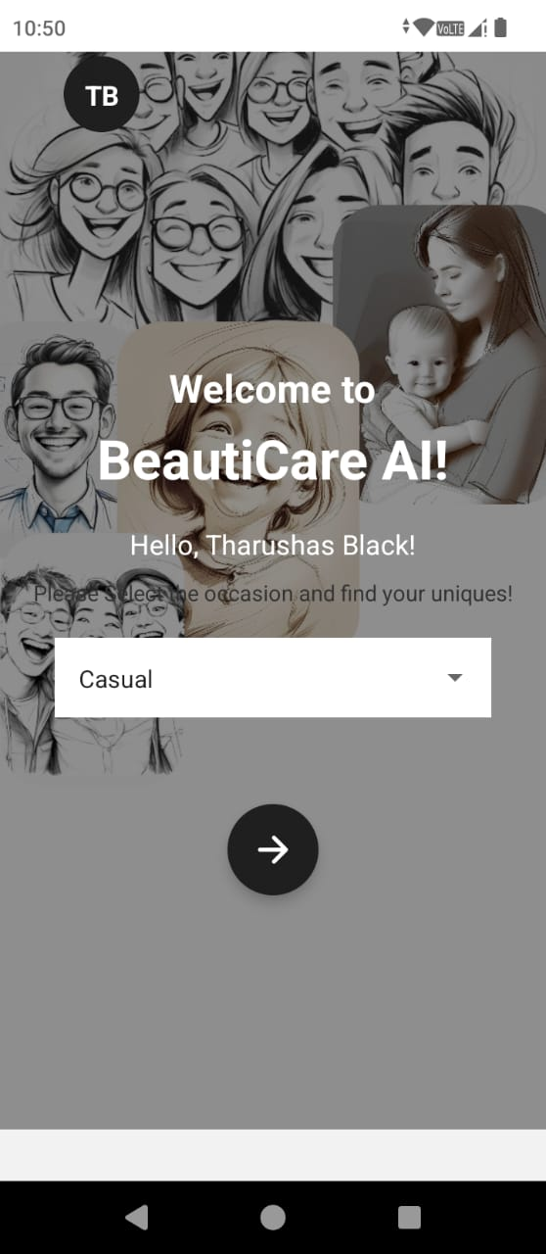
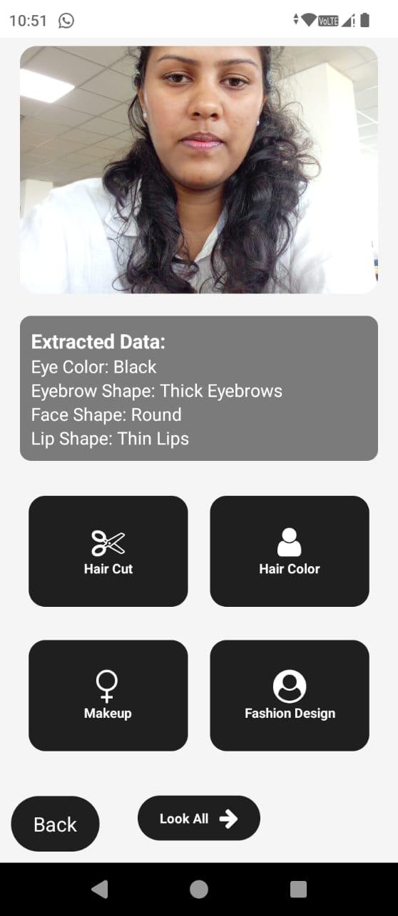
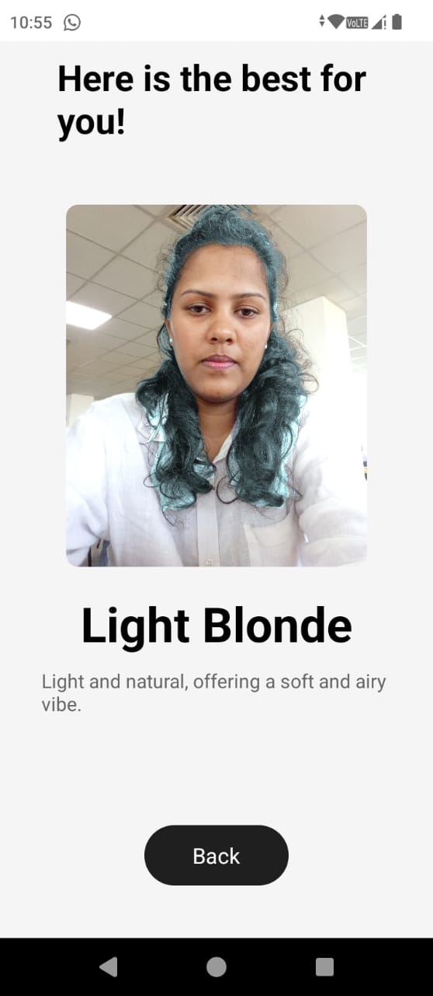
Evidence of Completion
IT21894824 | Prasadi S.A.D.T. | 24-25J-155
17/3/2025

Slide 18
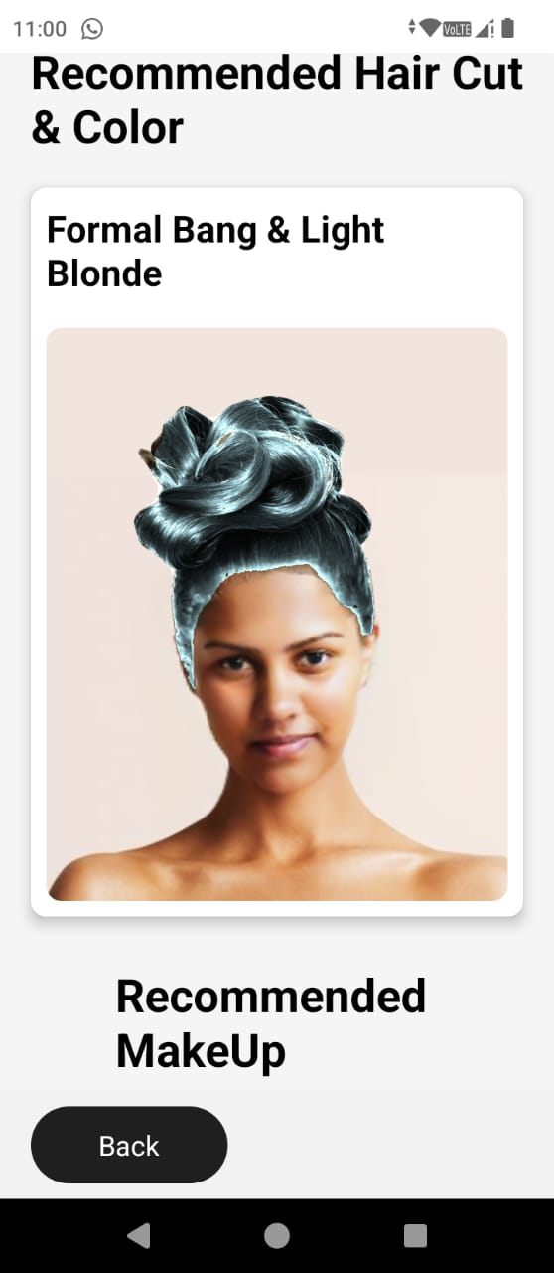
Evidence of Completion
IT21894824 | Prasadi S.A.D.T. | 24-25J-155
17/3/2025

Slide 19
IT21322280 | Shaakir J.H.M
Specialization : Software Engineering
IT21322280 | Shaakir J.H.M | 24-25J-155
17/3/2025

Slide 20
Clothing Recommendations based on body type & skin tone
IT21322280 | Shaakir J.H.M | 24-25J-155
17/3/2025

Slide 21
Research Problem
Existing recommendation systems generally suggest clothes based on user’s recent searches, previous orders. (Content Based Filtering)
Skin tone & body type plays a huge role when choosing a cloth. These attributes are rarely considered in the current recommendation system.
Less personalized & tailored for the users.
IT21322280 | Shaakir J.H.M | 24-25J-155
17/3/2025

Slide 22
Solution
User uploads an image of him/her covering their full body.
They manually input their gender & the occasion.
Based on these inputs, our trained models will identify user’s body type and skin tone.
According to the identification, there’s a nested json file where we have predefined the recommendations as a text. It will be shown in the mobile app.
The text will be fed to google search image, then it will redirect to google and show similar clothes.
IT21322280 | Shaakir J.H.M | 24-25J-155
17/3/2025

Slide 23


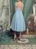
Challenges Faced
A smaller amount of free dataset is available to train the models.
Takes up a lot of space when building the mobile app.
Have to pay for subscriptions to generate images as the final output. (Google API, Open AI, Bing Image)
*Low quality images were generated, when trying in the free tier.
IT21322280 | Shaakir J.H.M | 24-25J-155
17/3/2025

Slide 24
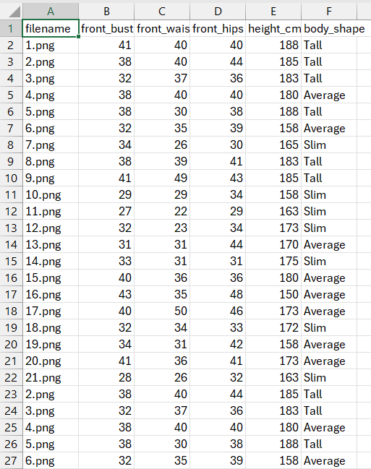
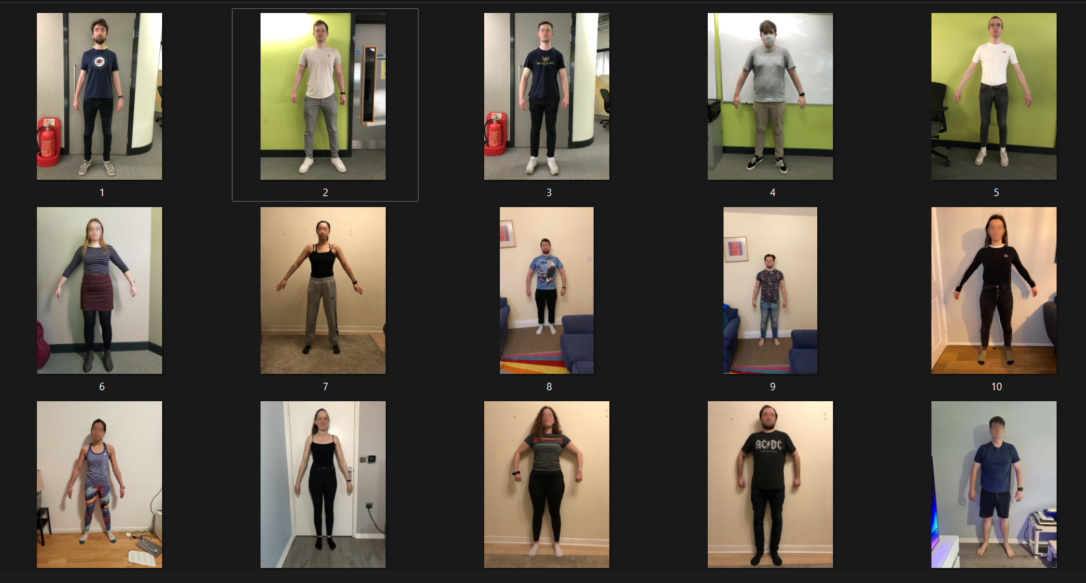
Data Collection
Collected dataset has images of various body types & different skin tones.
The dataset was collected from Newcastle University.
Also, it comes with a .csv file with measurements such as front bust, front waist, front hips, height & body shape.
IT21322280 | Shaakir J.H.M | 24-25J-155
17/3/2025

Slide 25
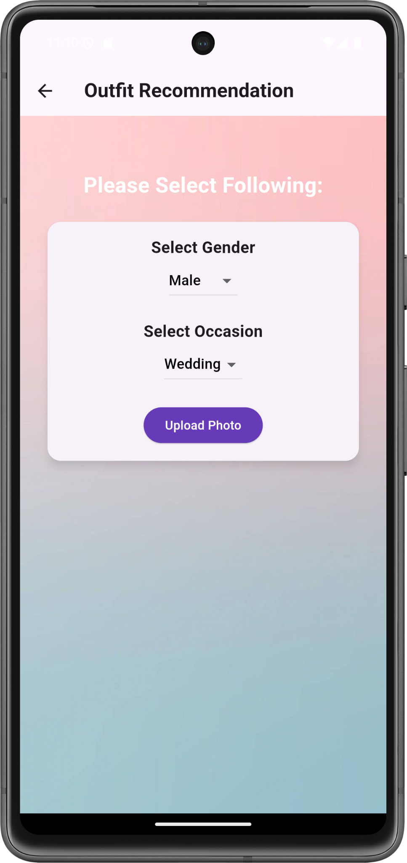
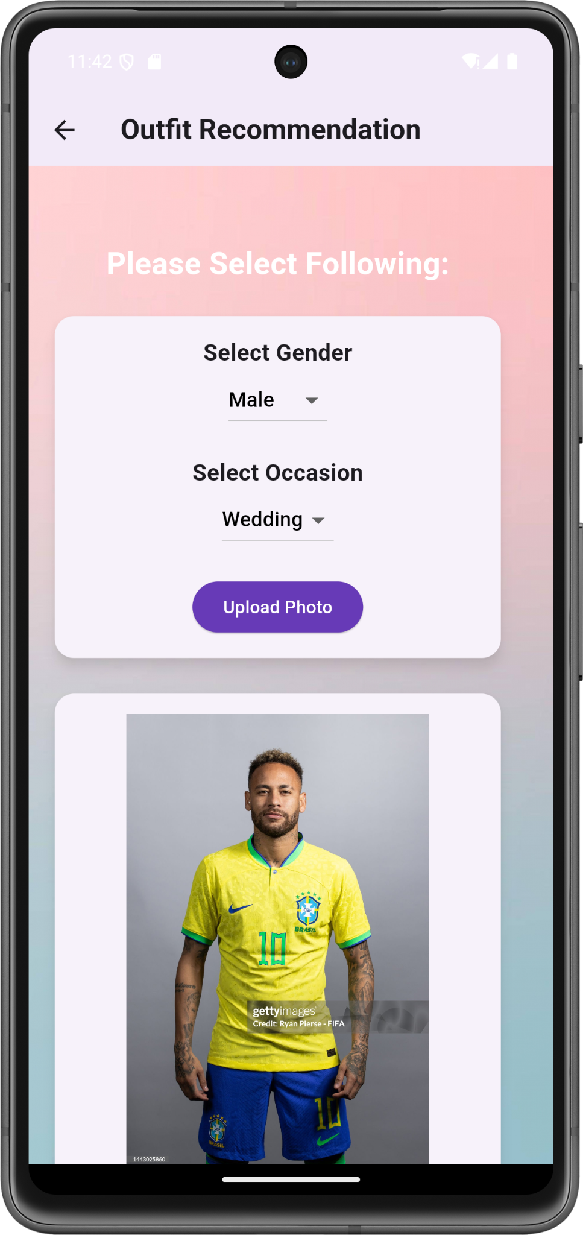
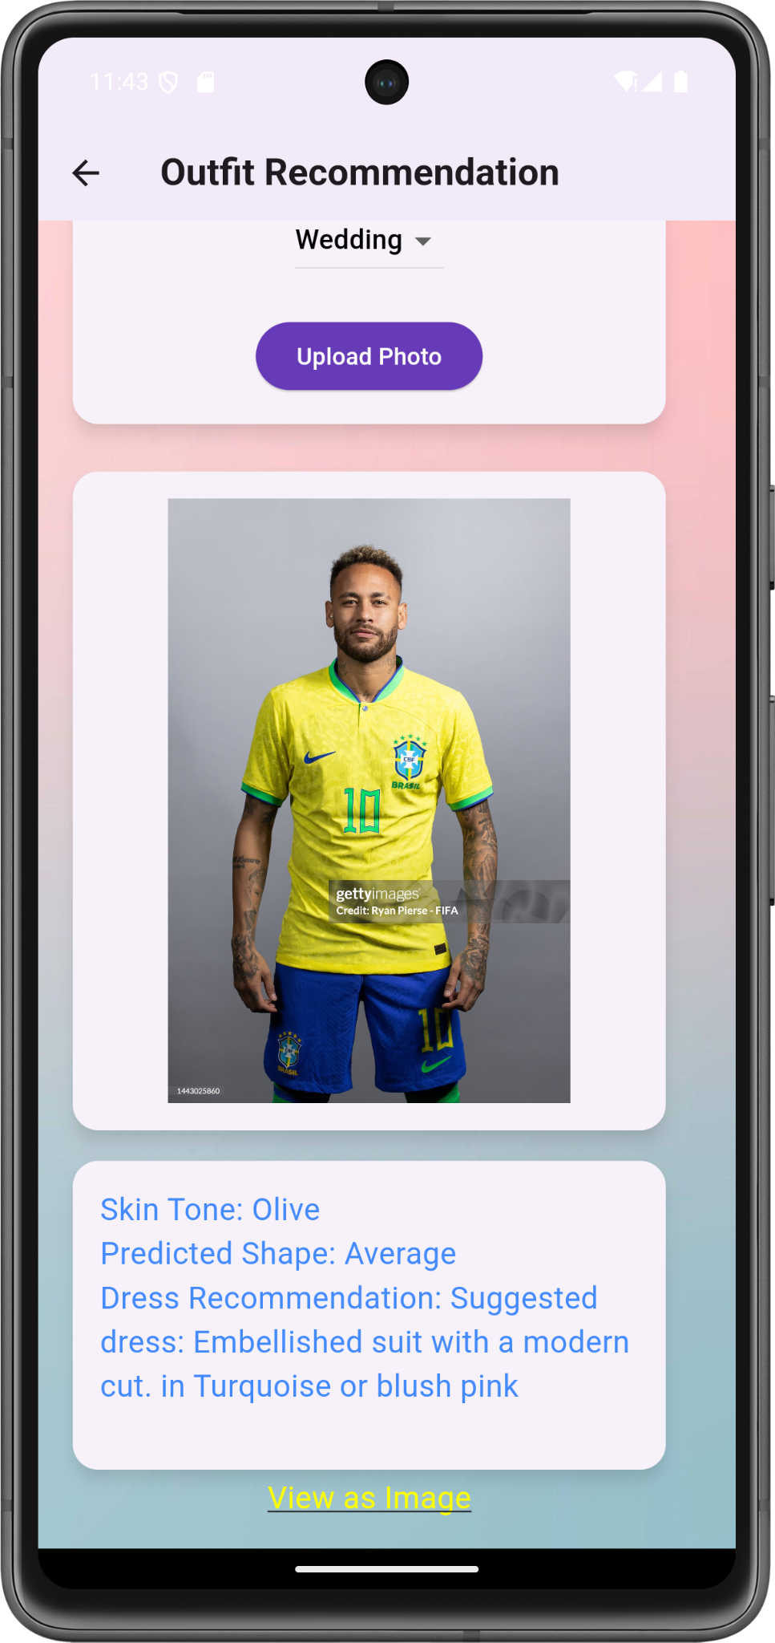
Design
Selection Page - 1
Selection Page - 2
Selection Page - 3
IT21322280 | Shaakir J.H.M | 24-25J-155
17/3/2025

Slide 26
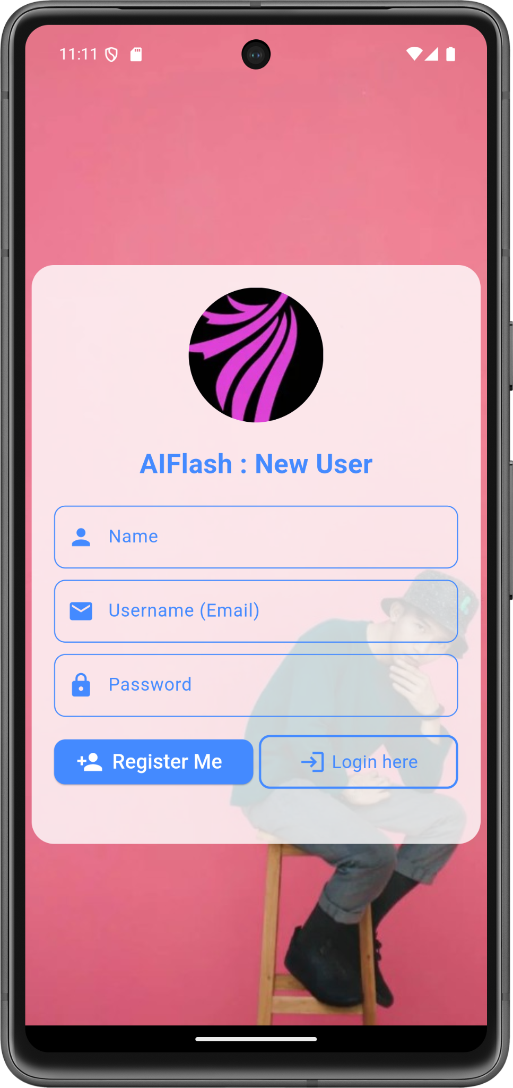
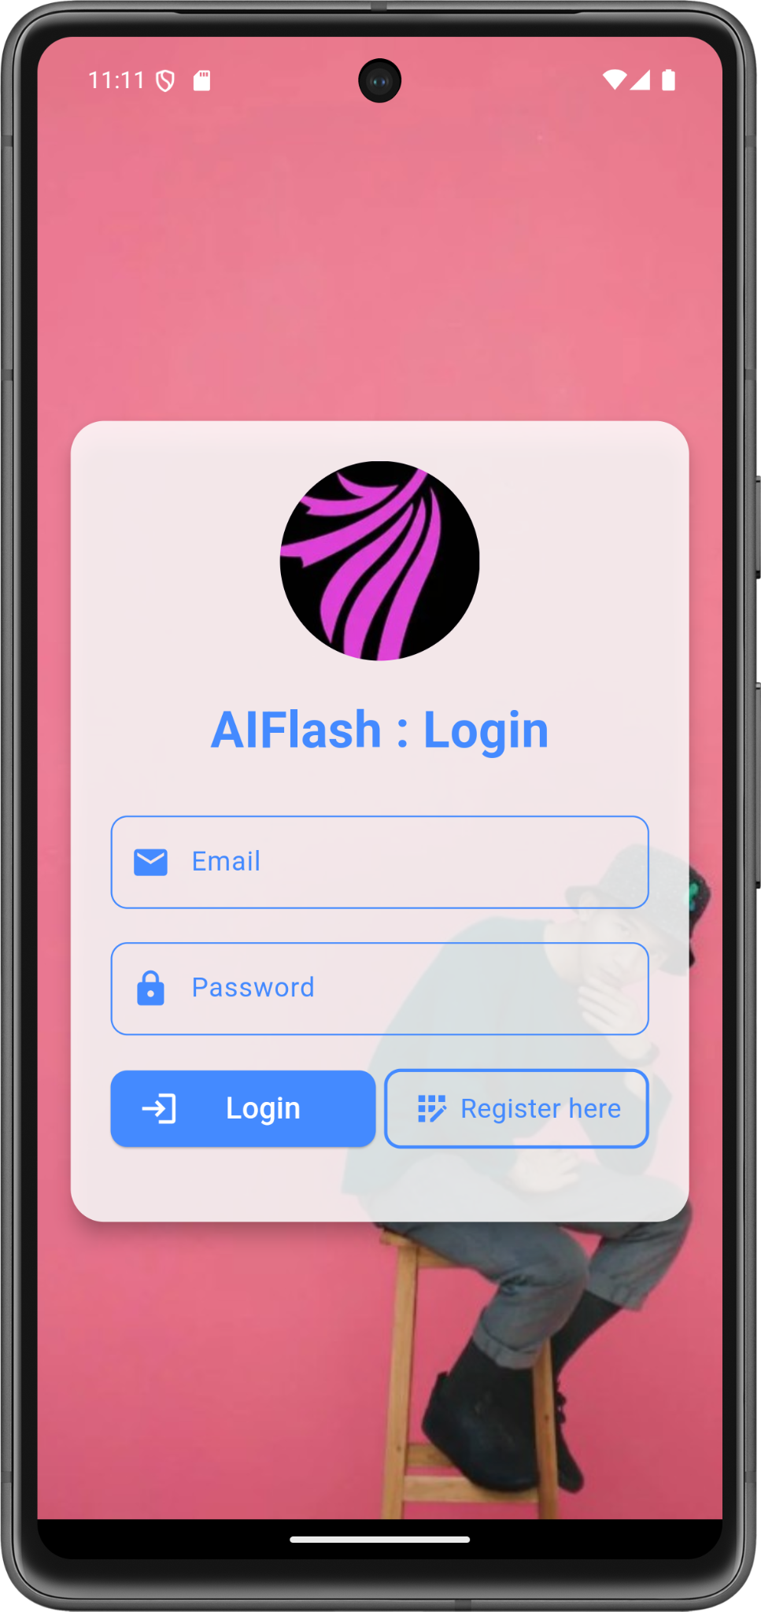
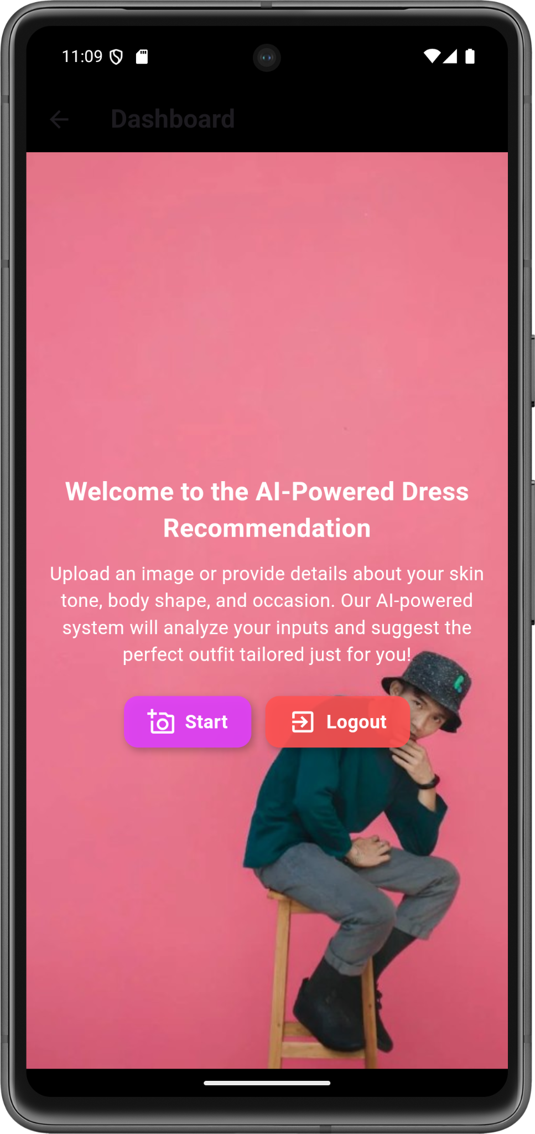
Design
Register Page
Login Page
Home Page
IT21322280 | Shaakir J.H.M | 24-25J-155
17/3/2025

Slide 27
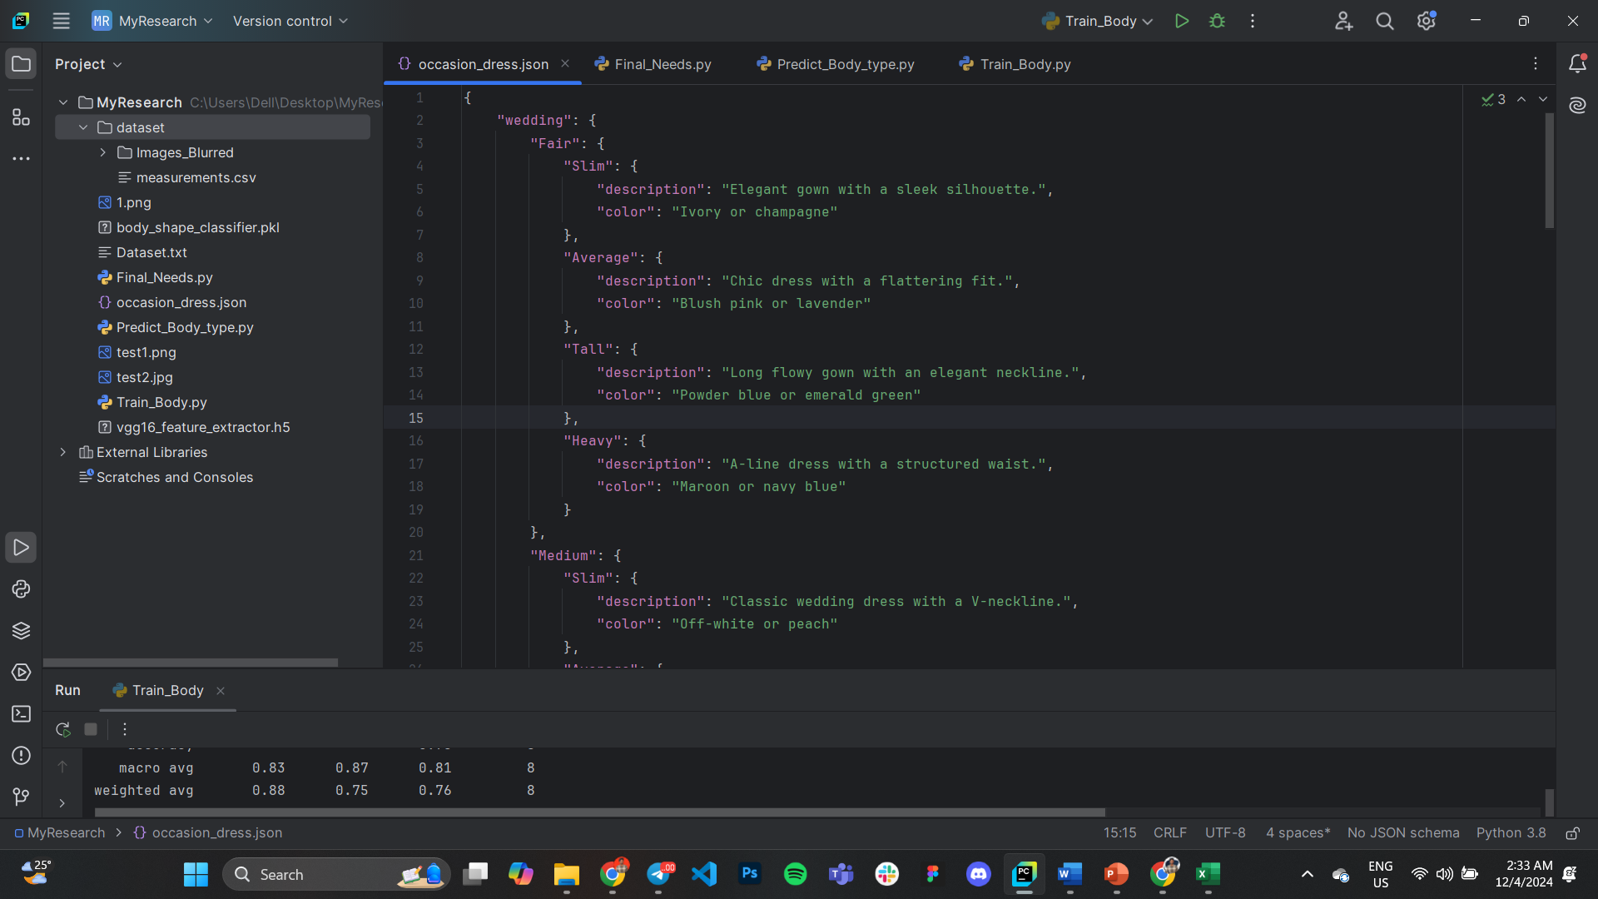
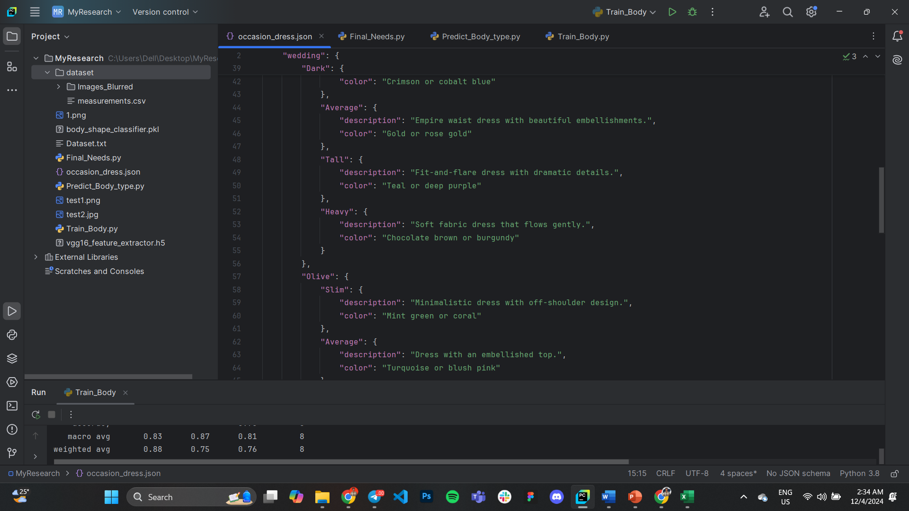
Data classification .json file
Based on occasion, skin tone & body type different output will be generated. Those key value pairs are stored in a .json file.
IT21322280 | Shaakir J.H.M | 24-25J-155
17/3/2025

Slide 28

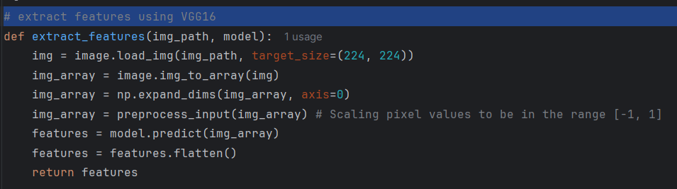
Model Training
I have used VGG16 as the architecture. It is an advanced version of CNNs.
It consists of 16 layers, including 13 convolutional layers and 3 fully connected layers.
It uses Softmax as the activation function, to ensure the cumulative outcome probability is 1.
Image gets load into the function and then pre processing happens, followed by feature extraction
IT21322280 | Shaakir J.H.M | 24-25J-155
17/3/2025

Slide 29
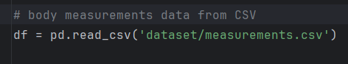
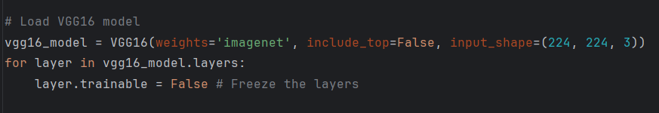
Model Training
Reads tabular data from .csv file
Loads VGG16 Model
IT21322280 | Shaakir J.H.M | 24-25J-155
17/3/2025

Slide 30
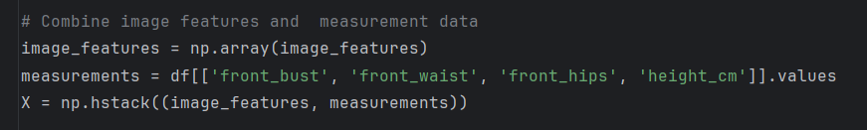
Model Training
Combines the features extracted using VGG16 and data read from .csv file
Encodes the body shape labels into numerical values to make them compatible with machine learning algorithms.
Dataset is split into training (80%) & testing (20%)
IT21322280 | Shaakir J.H.M | 24-25J-155
17/3/2025

Slide 31
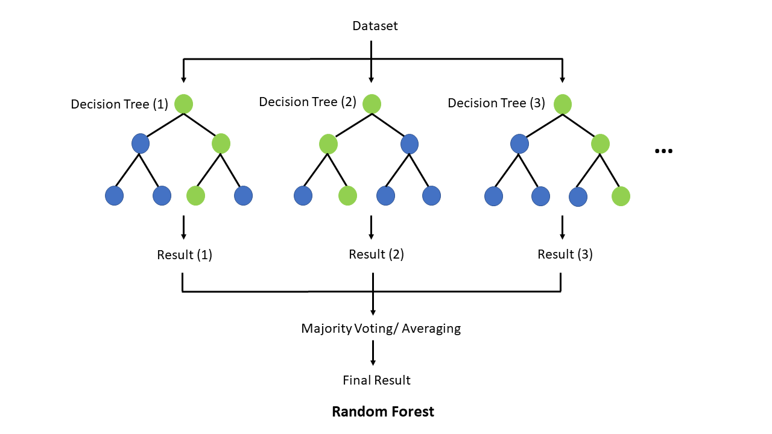
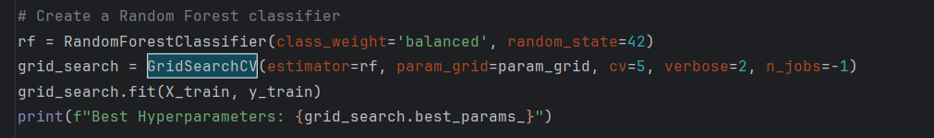
Model Training
I have used Random Forest Classifier (RFC) for body shape classification.
It is a supervised machine learning algorithm.
Hyper parameter tuning is used in RFC.
IT21322280 | Shaakir J.H.M | 24-25J-155
17/3/2025

Slide 32
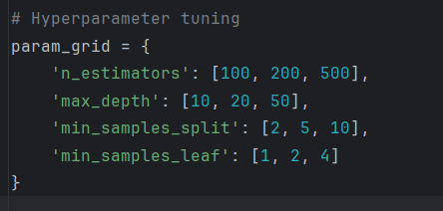
Model Training
This defines the hyperparameters that needs to be tuned
IT21322280 | Shaakir J.H.M | 24-25J-155
17/3/2025

Slide 33
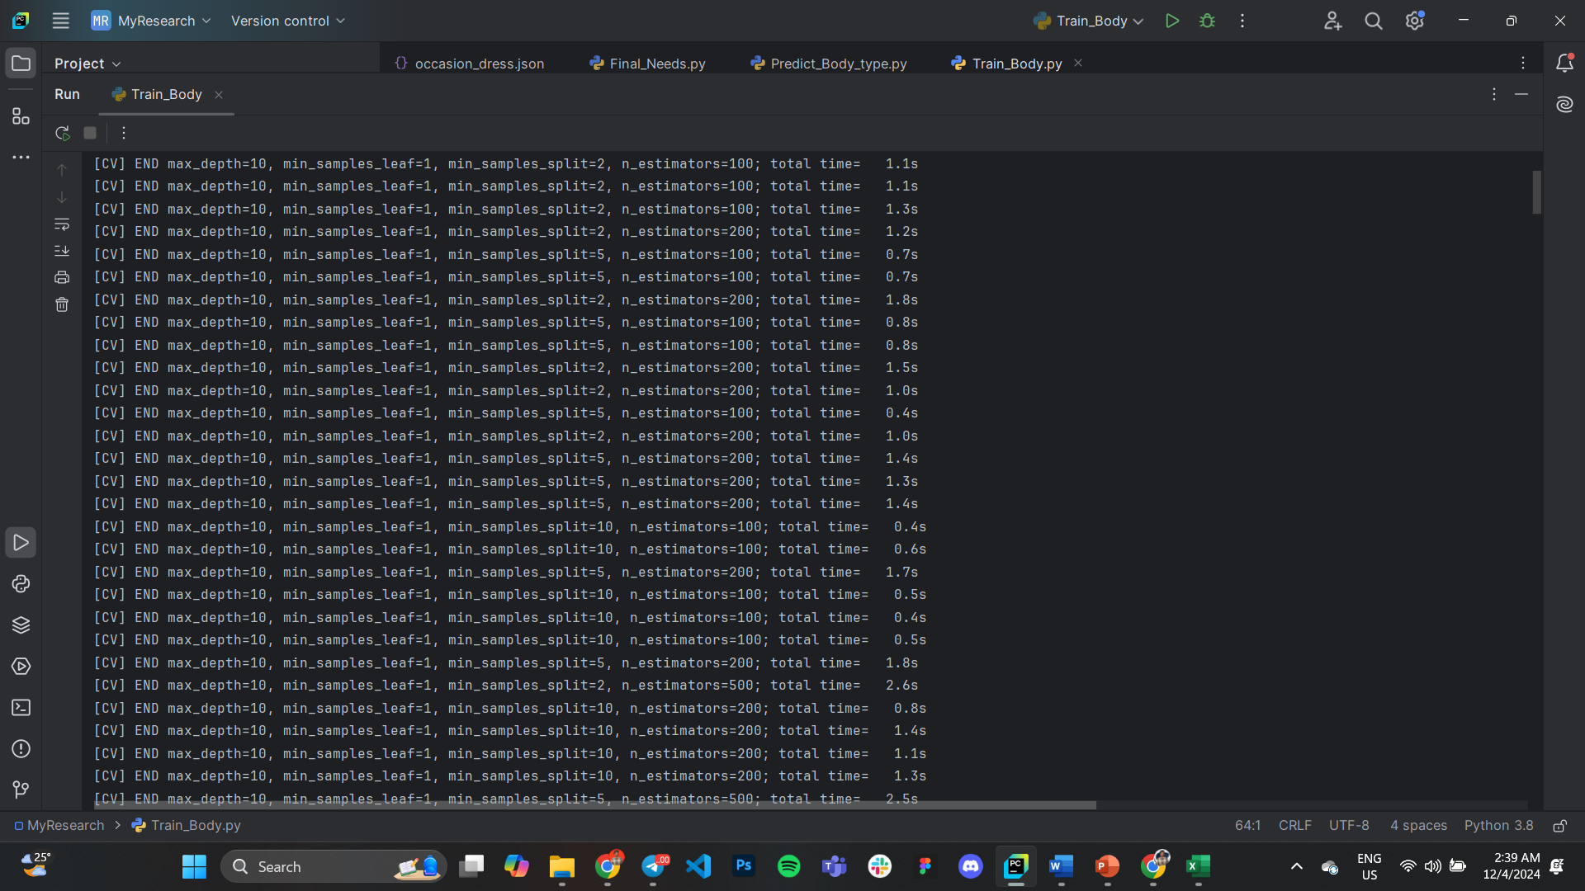
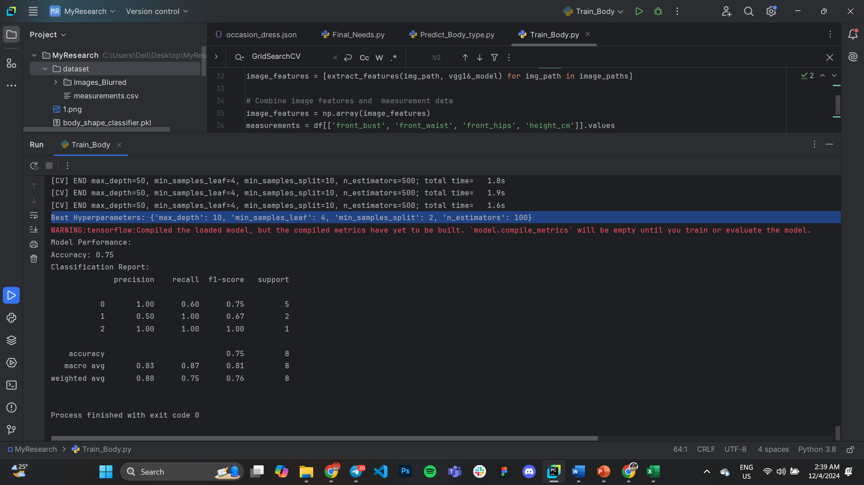
Model Training
Finds out the optimal hyper parameters and displays it
IT21322280 | Shaakir J.H.M | 24-25J-155
17/3/2025

Slide 34
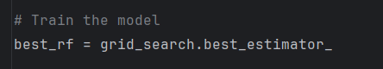
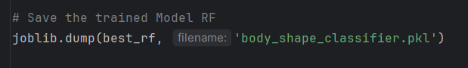
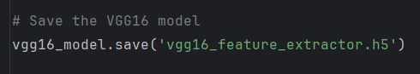
Model Training
Trains the best RFC model
Saves the RFC model
Saves the VGG16 model
IT21322280 | Shaakir J.H.M | 24-25J-155
17/3/2025

Slide 35
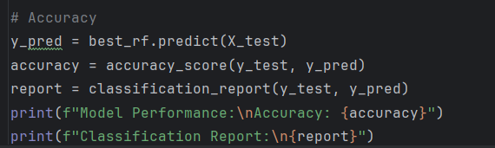
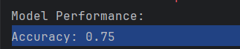
Model Training
Evaluates the model performance
Model gets an accuracy of 75%
IT21322280 | Shaakir J.H.M | 24-25J-155
17/3/2025

Slide 36
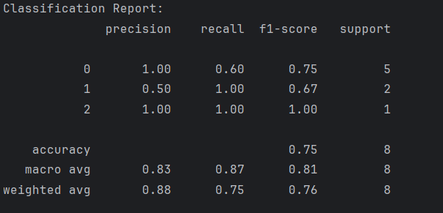
Model Training
Classification Report
IT21322280 | Shaakir J.H.M | 24-25J-155
17/3/2025

Slide 37
Commercialization
B2C – Fashion Assistant App/Website
Users upload photos, their personal info & get AI-driven outfit recommendations.
Revenue: Freemium model, subscriptions, affiliate marketing, in-app purchases.
B2B – E-Commerce & Retail Integration
AI-powered recommendations integrated into fashion retail sites.
Revenue: SaaS subscription, API monetization, revenue sharing.
IT21322280 | Shaakir J.H.M | 24-25J-155
17/3/2025

Slide 38
Commercialization
White-Label Solution for Fashion Brands & Stylists
Custom AI recommendation tool for brands & personal stylists.
Revenue: One-time setup fee + recurring subscription.
AI-Powered Virtual Try-On (Future Expansion)
Combine AI with AR for a virtual dressing experience
Revenue: Premium AR features, business partnerships
IT21322280 | Shaakir J.H.M | 24-25J-155
17/3/2025

Slide 39
IT21180798 | Vikasitha M.K.I.
Specialization: Information Technology
IT21180798 | Vikasitha M.K.I. | 24-25J-155
17/3/2025

Slide 40
Hair Cuts Transformation and Realistic Simulation for Personalized Recommendations
IT21180798 | Vikasitha M.K.I. | 24-25J-155
17/3/2025

Slide 41
Research Problem
When and where to use image processing while detecting the person’s region?
How many resources and machine learning or deep learning models are required to identify the face shapes?
What are the technologies required to present real-time hairstyles that match the face shape?
How to develop and implement deep learning models running in optimal conditions with minimal resource components
IT21180798 | Vikasitha M.K.I. | 24-25J-155
17/3/2025

Slide 42
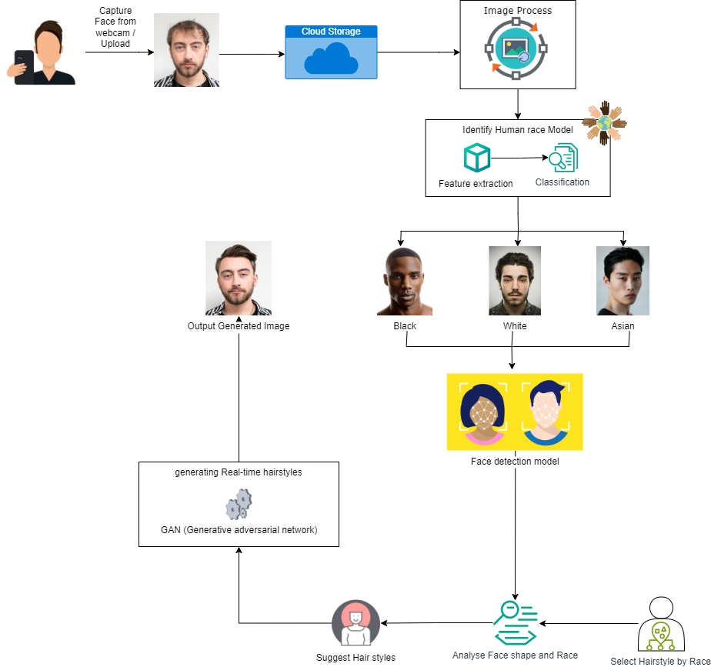
Methodology
IT21180798 | Vikasitha M.K.I. | 24-25J-155
17/3/2025

Slide 43
Specific and Sub Objective
Identification of User Face Shapes
Hair Cuts Transformation and Realistic Simulation for Personalized Recommendations
Identification of Optimal Face Shape Based on User Attributes
Best Haircuts Suggestions
Generate Appropriate Haircuts For User Using XGBoost
IT21180798 | Vikasitha M.K.I. | 24-25J-155
17/3/2025

Slide 44
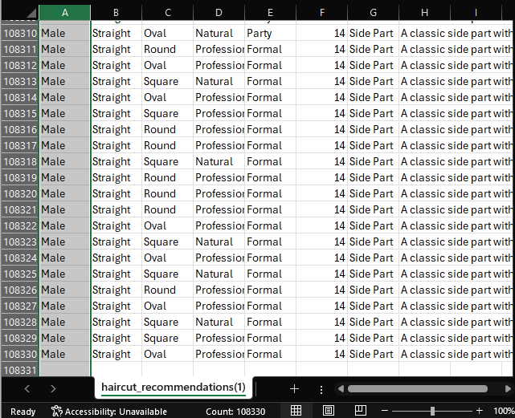
Finalized Dataset
Used for a haircut recommendation system based on user attributes.
Total Records 108,330 entries for various haircut suggestions.
Features (Columns):
Gender – Male or Female.
Hair Type – Straight, Curly.
Face Shape – Round, Oval, Square
Look Type – Natural, Trendy, Professional
Occasion – Casual, Formal, Party.
Haircut Name – Name of the recommended haircut.
Description – Brief details about the haircut style.
IT21180798 | Vikasitha M.K.I. | 24-25J-155
17/3/2025

Slide 45
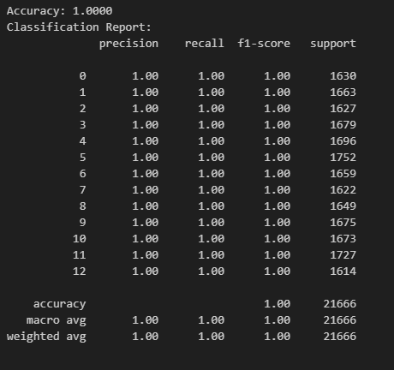
Expected Output of the Model
Why XGBoost?
XGBoost is used for the following reasons:
It is highly efficient and optimized for speed and performance.
It handles missing values and large datasets well.
It can identify complex relationships between features.
It prevents overfitting using regularization.
It supports parallel computing, making training faster.
IT21180798 | Vikasitha M.K.I. | 24-25J-155
17/3/2025

Slide 46
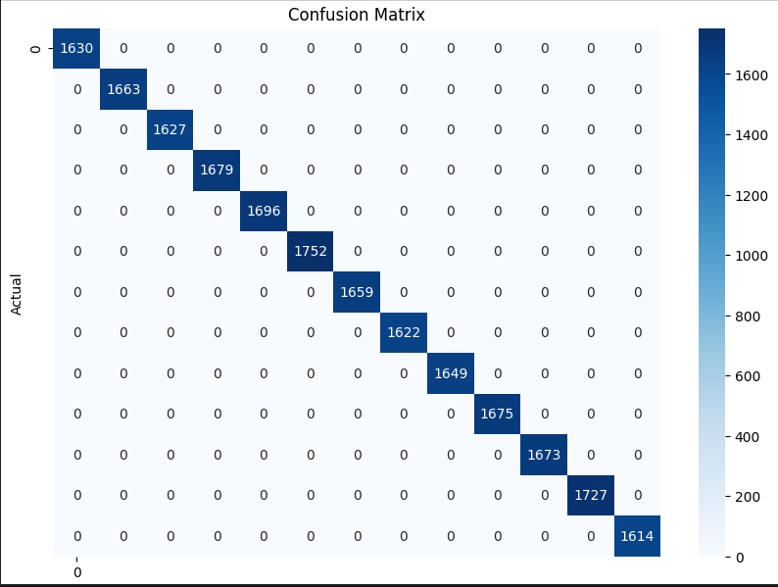
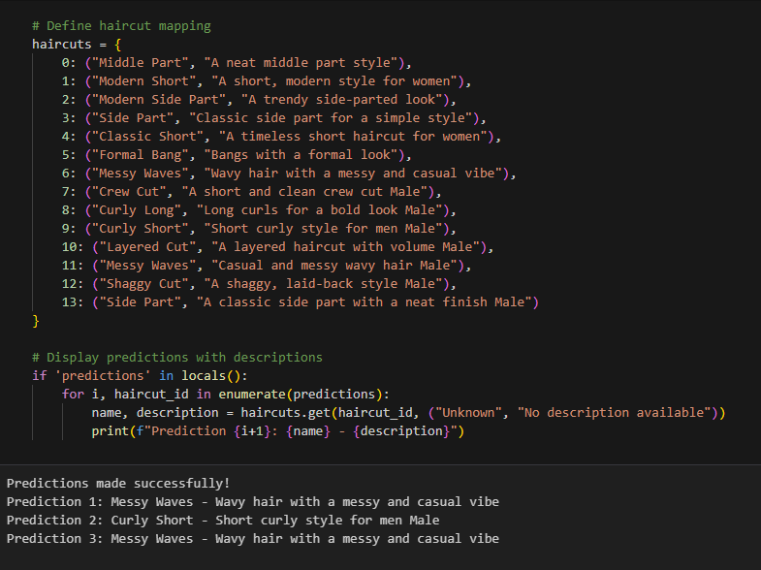
Model Configuration
Training Dataset: 80% of the dataset for training.
Testing Dataset: 20% of the dataset for testing.
Oversampling: SMOTE is applied to balance the classes.
Performance Metrics:
Accuracy
Confusion Matrix
Classification Report
IT21180798 | Vikasitha M.K.I. | 24-25J-155
17/3/2025

Slide 47
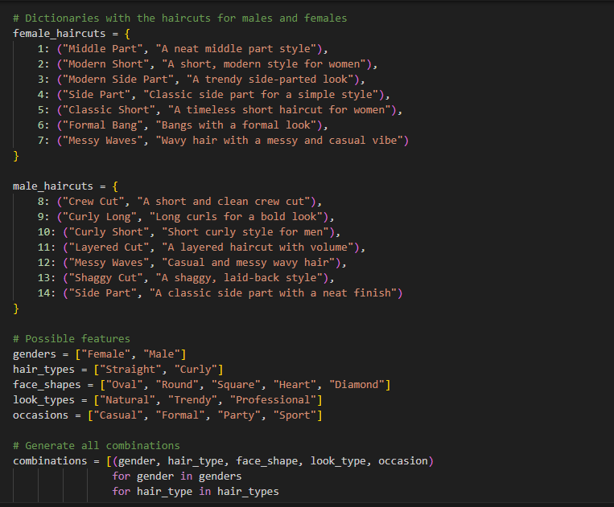
Recommended Haircuts
IT21180798 | Vikasitha M.K.I. | 24-25J-155
17/3/2025

Slide 48
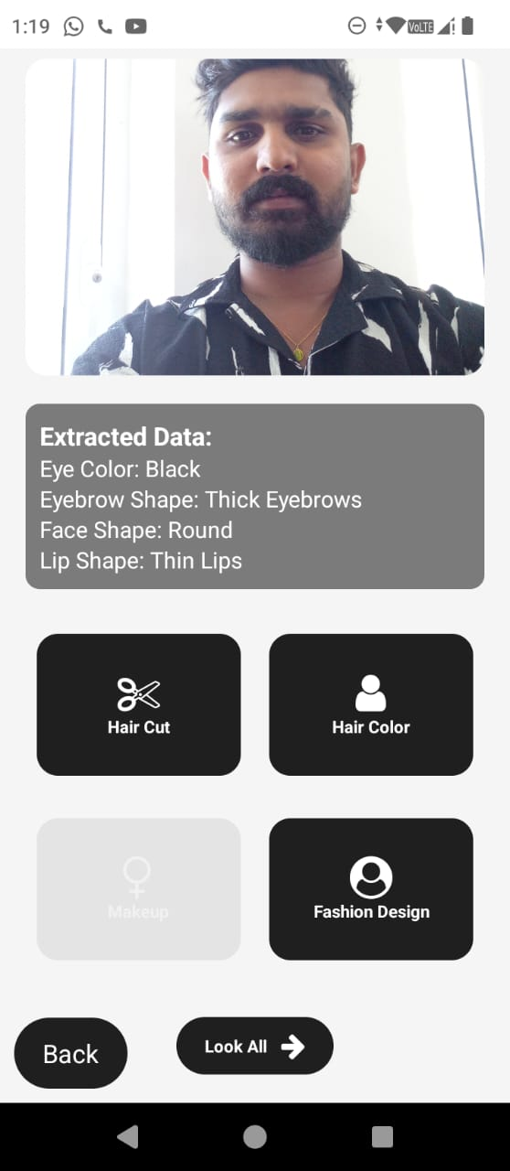
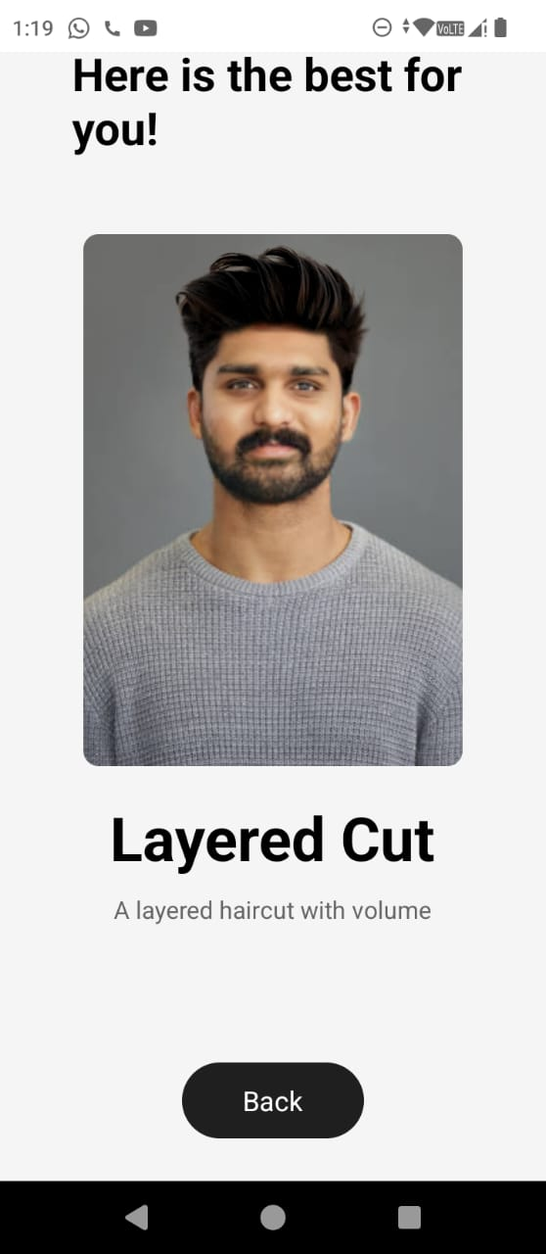
Evidence of Completion
IT21180798 | Vikasitha M.K.I. | 24-25J-155
17/3/2025

Slide 49

IT21213144 | Senarathne D.R
Specialization : Information Technology
IT21213144 | Senarathne D.R. | 24-25J-155
17/3/2025

Slide 50
Makeup recommendation based on facial features.
IT21213144 | Senarathne D.R. | 24-25J-155
17/3/2025

Slide 51
Methodology
Data Collection
Model Development
Feature Extraction
Prediction and Output
Data Preprocessing
IT21213144 | Senarathne D.R. | 24-25J-155
17/3/2025

Slide 52
Specific and Sub Objective
Identification of User Facial Features
Makeup recommendation based on facial features
Identification of Optimal makeup look Based on User Attributes
Recommend Suitable Makeup look
Generate makeup look image with a description of how each features makeup will apply
Progress Presentation 1
24-25J-155
17/3/2025

Slide 53
Research Problems
The accuracy of facial feature extraction is a major challenge, especially for lip shape and eyebrow structure.
Lighting, image quality, and facial angles can affect the correct detection of features.
Many existing datasets lack diversity, leading to biases in makeup recommendations.
The recommendations must align with professional makeup artist expertise to gain user trust.
IT21213144 | Senarathne D.R. | 24-25J-155
17/3/2025

Slide 54
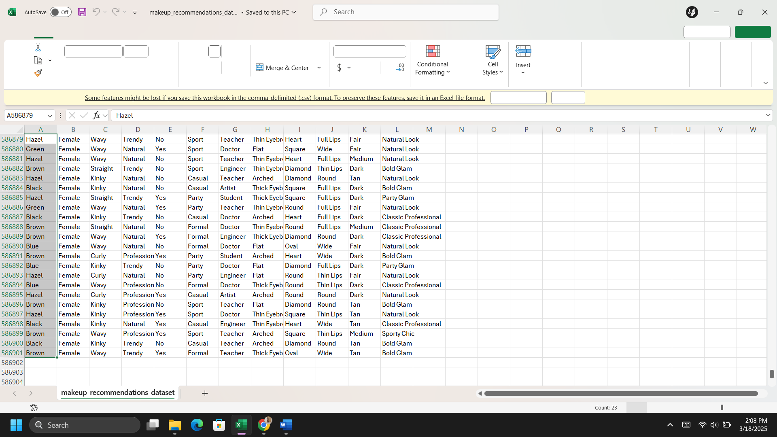
Finalized Dataset
Total dataset records for makeup recommendation model contain of 586901 with different attributes taken
Gender
Hair type
Look type
Occasion
Occupation
Eyebrow
Face shape
Lip shape
Skin color
Makeup recommendation
Progress Presentation 1
24-25J-155
17/3/2025

Slide 55
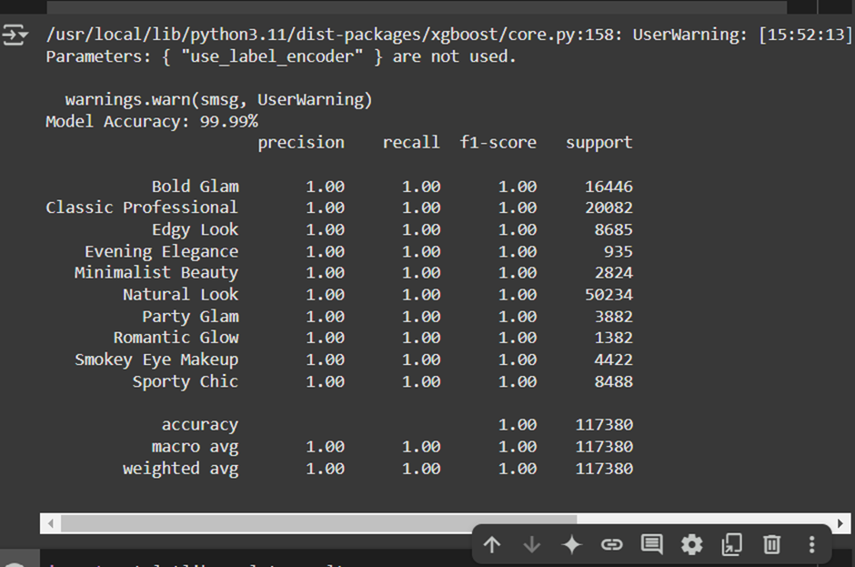
Expected Output of the Model
Why XGBoost?
XGBoost is used for the following reasons:
It is highly efficient, fast, and optimized for large datasets.
It prevents overfitting through regularization techniques.
It can model complex, non-linear relationships between features.
It supports parallel processing, making the training process faster.
It performs well in classification tasks, such as predicting hair color based on user features.
Progress Presentation 1
24-25J-155
17/3/2025

Slide 56
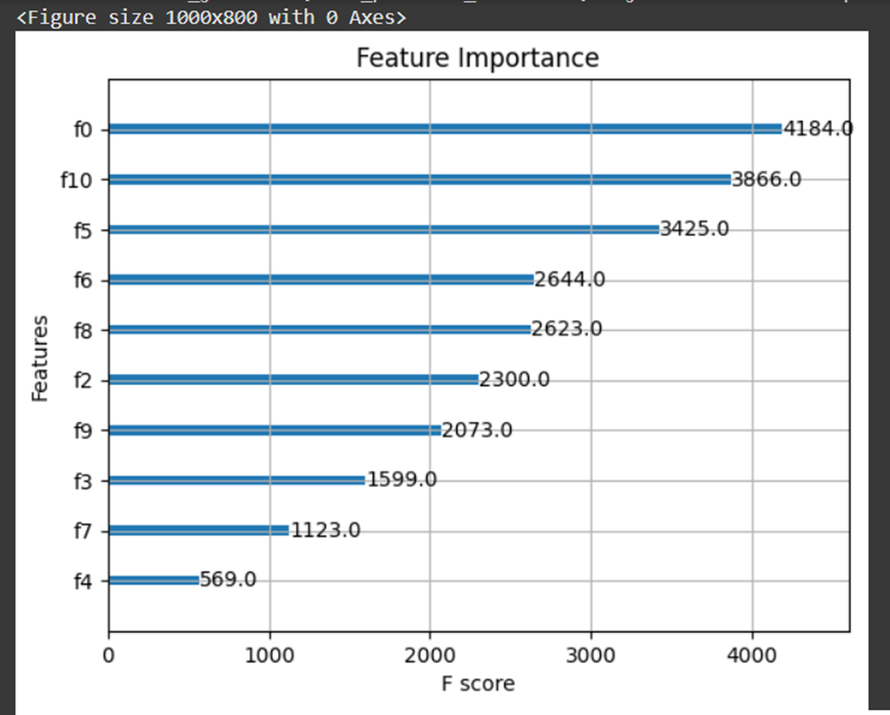
Model Configuration
Training Dataset: 80%
Testing Dataset: 20%
Oversampling: SMOTE applied to balance classes
Algorithm: XGBoost
Performance Metrics:
Accuracy
Confusion Matrix
Classification Report
Progress Presentation 1
24-25J-155
17/3/2025

Slide 57

Evidence of Completion
IT21180798 | Vikasitha M.K.I. | 24-25J-155
17/3/2025

Slide 58
Q & A
Progress Presentation 1
24-25J-155
17/3/2025

Slide 59
Thank You!
Progress Presentation 1
24-25J-155
17/3/2025

